Slide 1
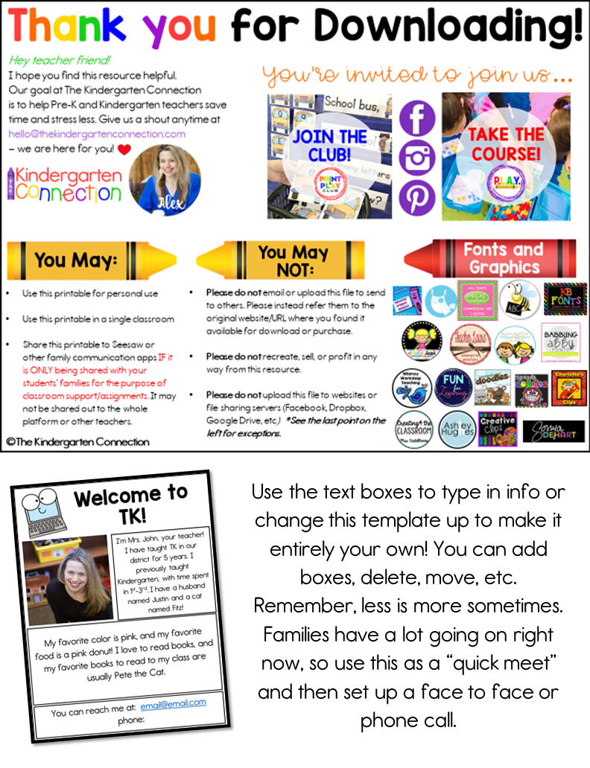

Slide 2

Welcome to
Kindergarten!
Tell about you here (ideas are professional history, family, pets – friendly info to get to know them)
Insert your picture here
A few of your favorite things (ideas are favorite color, favorite food, favorite children’s book, etc – these also lend to surface-level talking points on initial 1:1 with students and community builders.
Contact info, office hours, or important links

